Slide 1

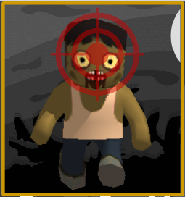
Target
ZOMBIE
Aryo Damar Prasetia | Asterik Rafael Winoto

Slide 2

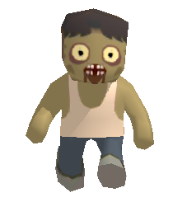
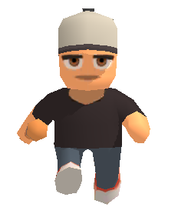
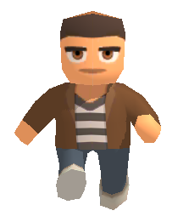
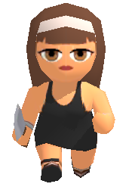
What's
Target
Zombie?
Endless Casual Mobile Game
Single Player Game
Eliminate the Zombies, save the Civilians

Slide 3
Why Target Zombie?
Casual Games are so popular
among Teenager
Many teenager interested
with the Zombie things
Many people aren't goal
oriented

Slide 4
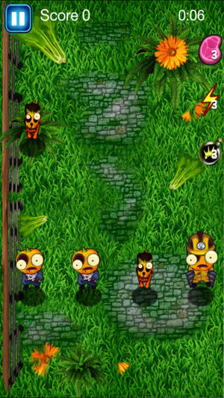
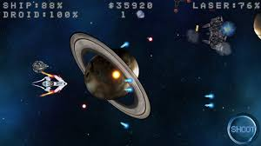
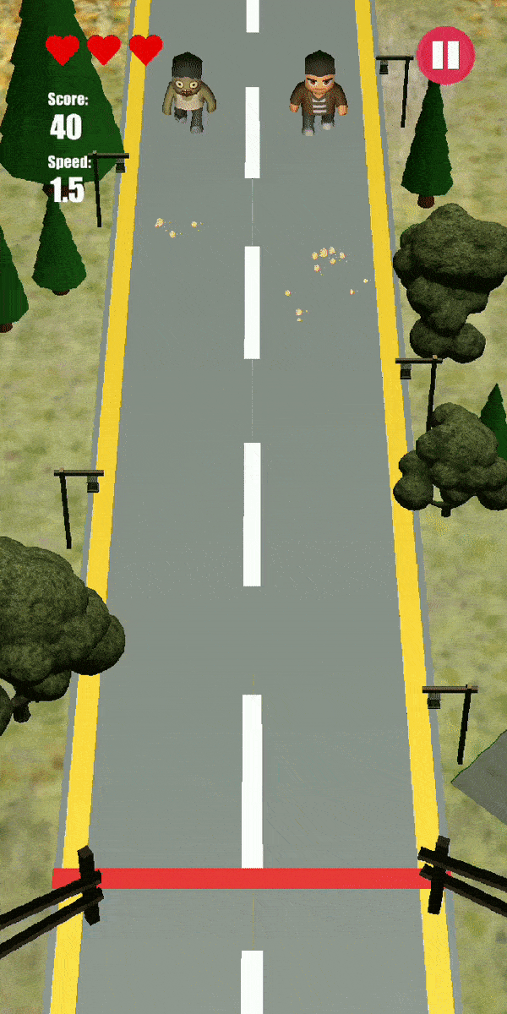
Target
Zombie
Concept
+
Space Shooter
Kill The Zombie:
Zombie Smasher
Player have to save civilian from zombie attack
Target
ZOMBIE

Slide 5
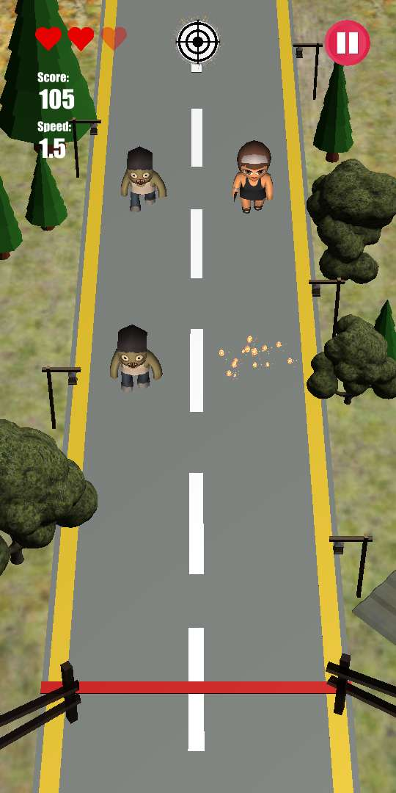
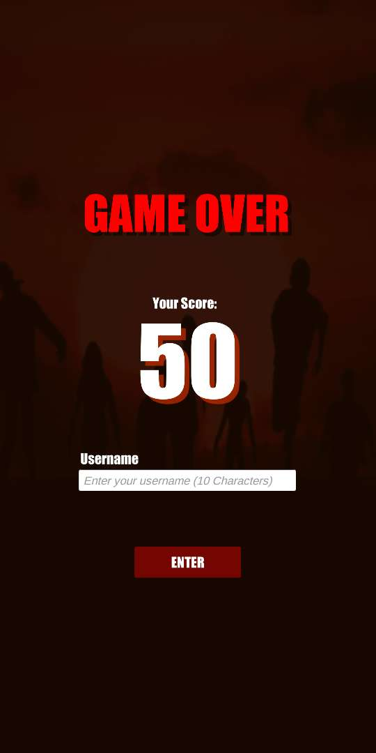
GAME LOOP
Get Score
Play Game

Slide 6

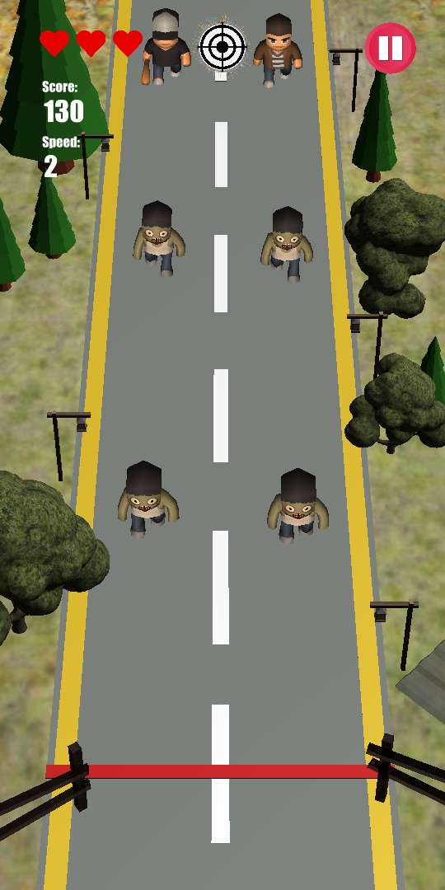


GAMEPLAY DETAIL
Kill the Zombie Save the Civilians
Zombies and Civilians will appearing randomly
Challenge the highest score
Each waves speed will increase
Score:
120
Speed:
1.5
Don't allow zombie to cross your safe zone

Slide 7
GAME CONTROLLER
Pause Button
Flash Kill
Current lives
Score and Speed
Tap to Shoot / Swipe to grab
Tap to Shoot / Swipe to grab

Slide 8
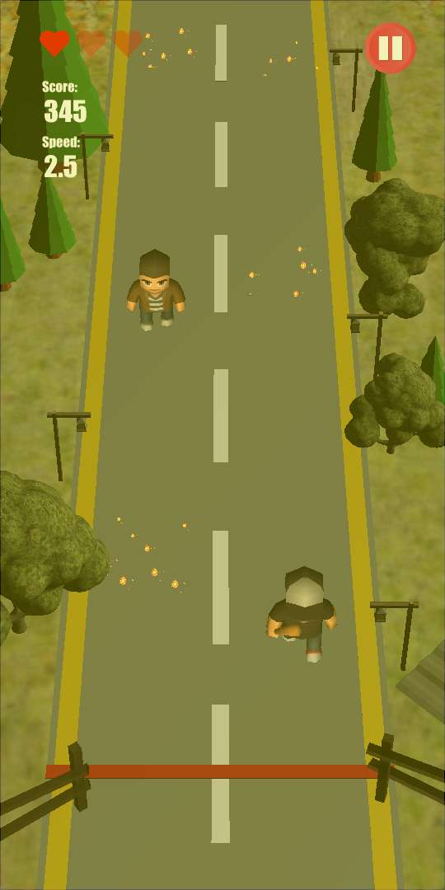
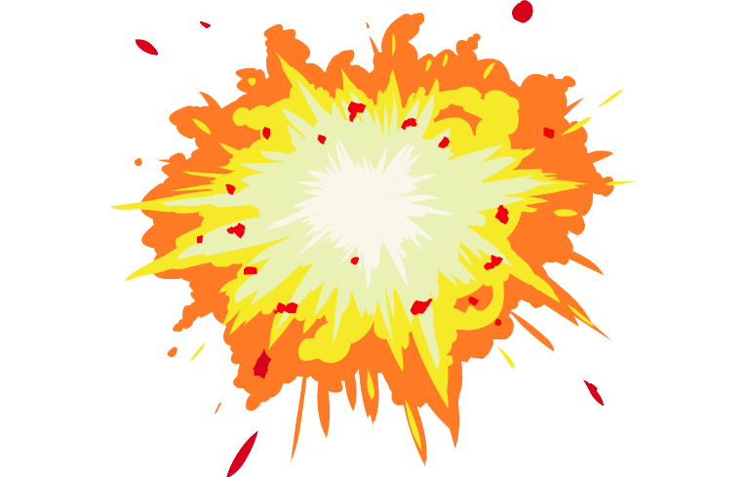


GAME CONTROLLER
Score:
120
Speed:
1.5
Use Flash Kill to eliminate
all Zombies in time
SAVED
Swipe to SAVE
civilian
Tap to SHOOT

Slide 9
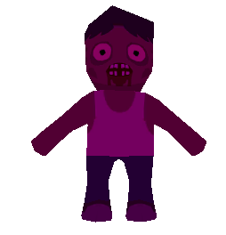
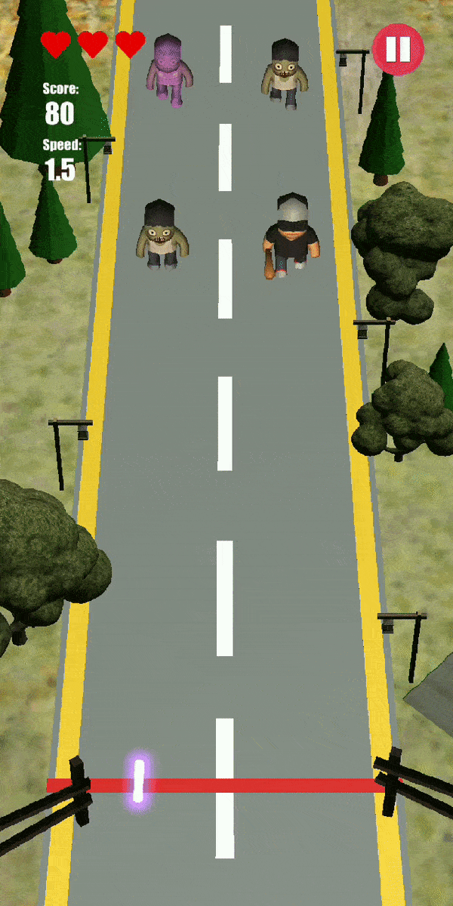
FlashKill Button will
appear when player
eliminate the special
Zombie
FlashKill
Detail

Slide 10

FlashKill
Detail
FlashKill will eliminate all of the zombie that appear in the arena

Slide 11
Game Art-Style
CIVILIANS
ZOMBIES
Player have to save civilian from zombie attack
SPECIAL
ZOMBIE

Slide 12
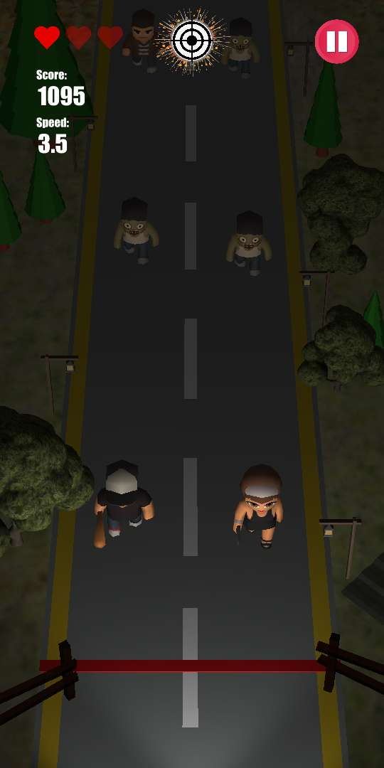
Day Mode
Game Mode
Night Mode
Day Night Rotation

Slide 13
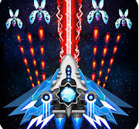
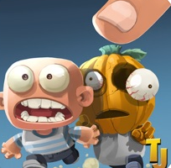
MARKET SHARE
Galaxy Attack:
Space Shooter
Kill The Zombie
zombie Smasher
Target
ZOMBIE
Have save and shoot feature rather than just shoot
Same concept but different controller
Need Concentration more than Galaxy Attack: Space Shooter
Eliminate zombie with tap the controller rather than tap the zombie object
Simple game
3D visual
3D visual
Save Civilian manually rather than wait the Civilian run to save line

Slide 14
Target Market
All gender
Chibi Toony character combine with the shooting game will be liked by all gender
Between 11 until 25 ages
In this range of ages are usually to play shooting
games
For casual
Easy to play and more fun playing together

Slide 15
Weakness
Single player only
Local Leaderboard
Player have to save civilian from zombie attack

Slide 16
Game
Target
UI
Main menu, leaderboard, setting,
select player, create new player, game
Over, in game
Zombie and Civilian spawner and
behaviour
Flash Kill effects and impact effect
Applying sound
Create Controller
Shoot and save
Interaction with Zombie and Civilian
Score and decreased lives

Slide 17
Additional
Features
Day Night Mode
Game Speed UI
Player have to save civilian from zombie attack

Slide 18
THANK YOU

